Slide 1
Google Stock Price Prediction
Prof – Gopichand G.
Team members –
Rishi Vamshi – 15BCE0327
J.V. Sai Srikar – 15BCE0520
Apurv Gupta – 15BCE0470

Slide 2
Long Short Term Memory
LSTM is a special recurrent neural network (RNN), it is one of the most powerful deep learning model.
classic RNN’s have short memory and therefore are not that popular for that reason.
but lstm’s have long memory, which gave rise to stronger and powerful deep learning models.
for this project, we took google stock price values for the last 5 years and exported them into a csv file.

Slide 3
Training the model
Take the google stock price for the last 5 years and we will train our recurrent neural network model in that.
during training, our model aims to find some patterns and once we do that, we will try to predict the google stock price for January month.
as we also have the actual stock price for January, we will be comparing them with that.
stock price prediction depends on many other factors, hopefully our RNN model finds and analyses all the patterns.

Slide 4
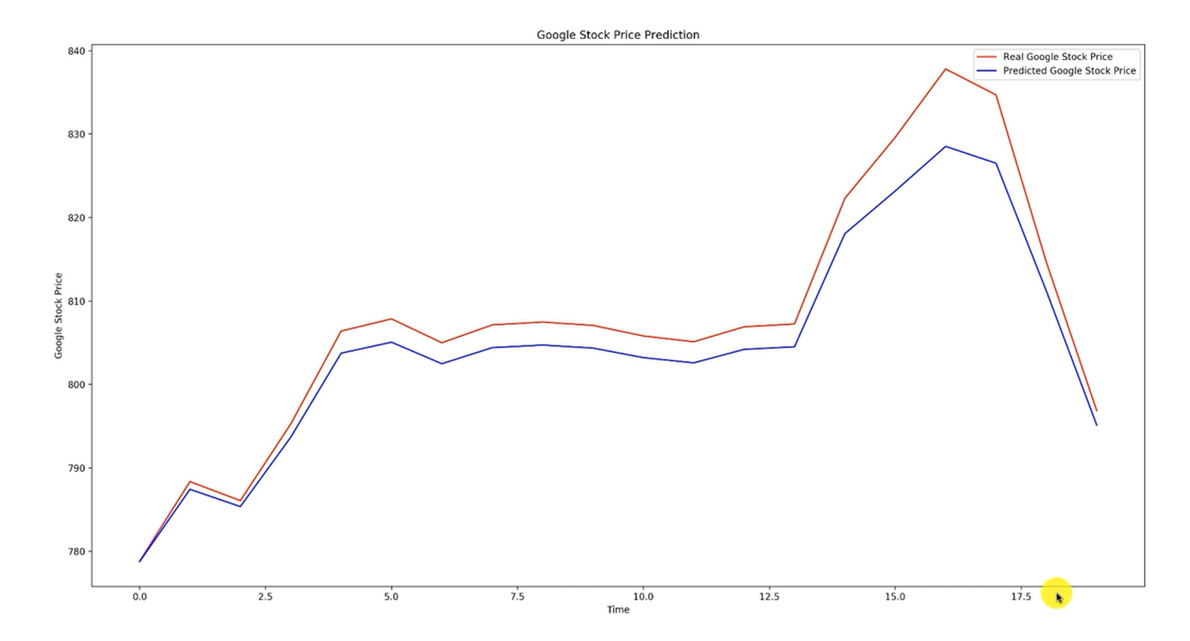
Results

